Slide 1


Multi Model Camera-based Human Activity Monitoring
Anusuya Manickavasagam - A0163300Y, Muni Ranjan - A0163382E Pradeep Kumar - A0163453H, Kesavan Sridhar – A0163207M
ISS-TJ

Slide 2

AGENDA
Objectives
High Level System Diagram
HMM Classification Module
Front End Development
Demo
Current challenges
Future Improvements
Agenda for the day

Slide 3
Objectives
IW 1
Setup Intel SDK and Camera connections
Do initial Video streaming and analysis
Differentiate between Active/Not Active users
IW 2
Based on learnings from past Re-define the System use cases
Implement the module for classification using feature engineering and Analytical Engine(HMM)
Re-construct the Webapp to cater to use cases
Paper to publish for Proposed app workflow
Defined the Objectives for the IW2

Slide 4

Business Research

Slide 5
Business Research
Prescribe the exercises
Patient performs
Make progress
Stops before prescribed
Patient visit Doc
Condition degrades again

Slide 6
High Level System Diagram

Slide 7



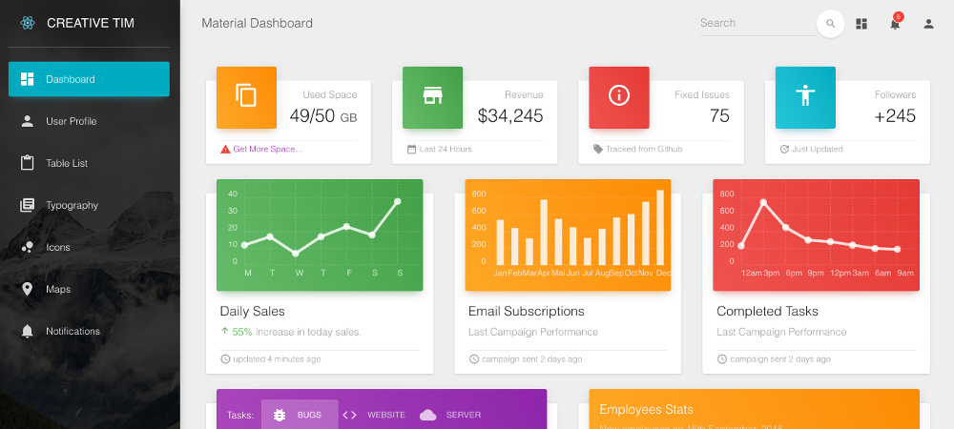
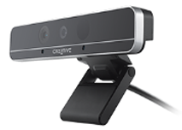

High Level System Diagram
Depth camera
Server (desktop)
Collect
Detect
Save
Dashboard
Present
PHYSIOTHERAPEUTIC
PATIENTS ACTIVITIY
Doctor prescribe activities goals (Hospital or in-Home)
Patient performs in front of Smart device
Device collect data (Privacy safe)
Server performs Data Op
Dashboard provide interface to maintain and present data

Slide 8
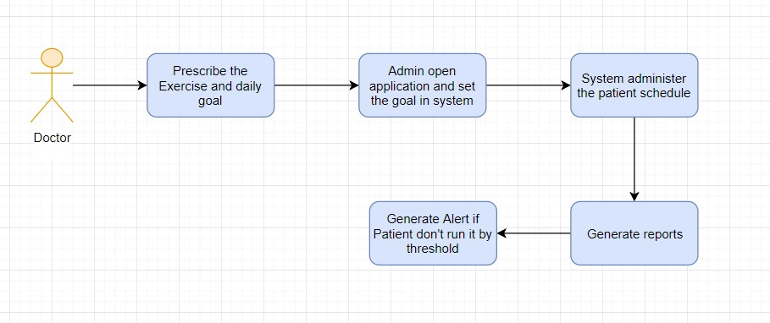
Admin Workflow

Slide 9
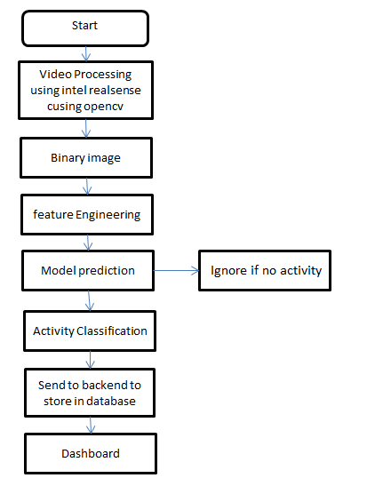
Flow Chart - Classification

Slide 10
Pose Classification Using HMM

Slide 11
Pose Classification using HMM
The approach employed is the Hidden Markov Model (HMM), which works very well with sequential data and is essentially a Markov process with hidden and unobservable states.
The actions are visible to the viewer, but the sequences that lead to the output are hidden.
Initially features were extracted before applying HMM as opposed to sending frames directly to HMM.
The model was trained for exercise like Head Bend, Situp, Hand raise on RGB as well as depth 2D frames.
Computer Vision capability using OpenCV and Python
Alert capability if the goal is not met

Slide 12
DEMO

Slide 13
Front End Development

Slide 14
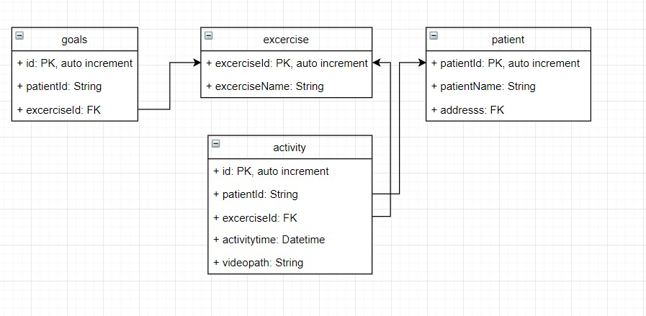
Tools & Development
Node JS was used for server backend to capture every second status and the video clip if there is alert
Lightweight SQLite Database
React JS was used for building user interface and thus display in the dashboard real time status(active and inactive)

Slide 15
Analysis/Challenges

Slide 16
Findings
Time constraint
Support community for intel board
Intel Board – Intermittent connectivity issues
Exploration of depth features
Poor Skeleton in-accuracies
Application/Overall concept in prototype

Slide 17
Documentation

Slide 18
Documentation
https://bitbucket.org/teamneo/videoanalytics
https://trello.com/#
https://docs.google.com

Slide 19

Thank You

